Slide 1





Slide 2
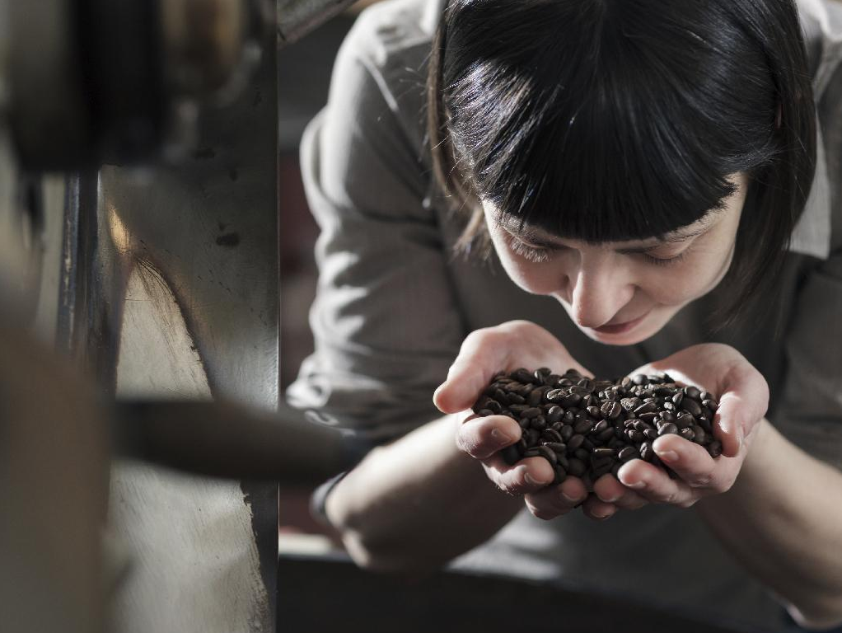

BARISTA INTERMEDIATE

Slide 3


HOUSEKEEPING
Introduction
Schedule
Restrooms
Phone Calls

Slide 4
OBJECTIVES
Identify different varieties of Arabica
Identify producing countries and general flavor profiles
Describe how processing methods impact flavor and body
Analyze coffee of different roast dates

Slide 5
REVIEW: SPECIES
Coffea Arabica
Coffea Canephora (Robusta)
Notes:
Ask students to explain the differences...

Slide 6
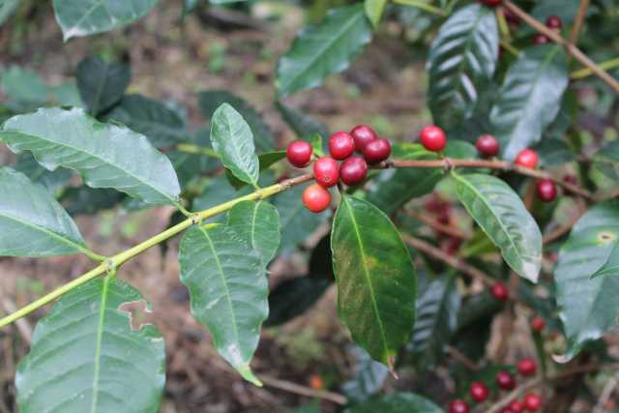
VARIETIES
Typica
Source: World Coffee Research Variety Catalog
Notes:
Bronze colored leaves, low yield but excellent cup quality, larger fruit/bean size

Slide 7
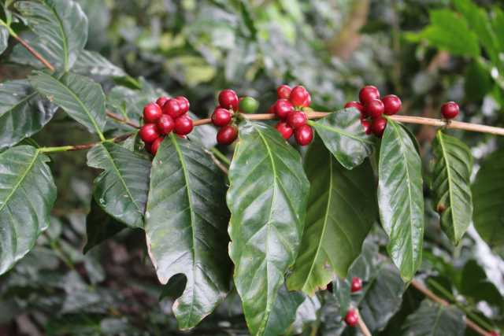
VARIETIES
Bourbon (bur-bone)
Source: World Coffee Research Variety Catalog
Notes:
Green leaf color, slightly higher yield while maintaining excellent cup quality

Slide 8
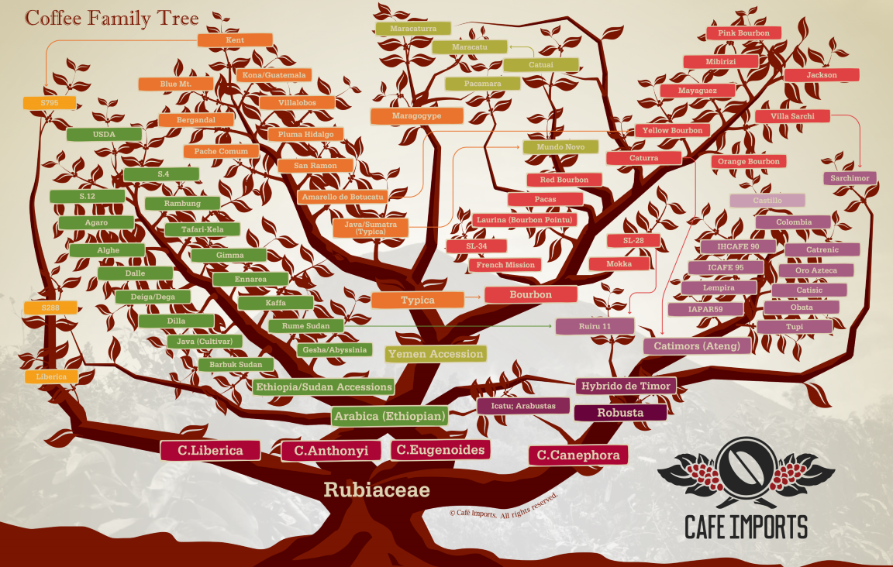

Slide 9

Notes:
what do we call the area within the yellow lines? Coffee belt, regions near the equator

Slide 10
ORIGINS
Central & South America
East Africa
Southeast Asia
Notes:
Different flavor profiles from varying weather conditions, soils, altitudes, traditional methods, etc...

Slide 11
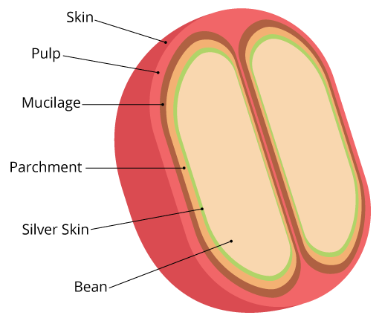
PROCESSING
Different ways to remove layers

Slide 12
PROCESSING
Washed / Parchment-dried
Natural / Fruit-dried
Honey / Semi-washed
Experimental - adding in yeasts or enzymes during fermentation
Notes:
Also mention Wet/Dry/Pulped Natural...interchangeable terms.

Slide 13
GENERAL PROFILES
Body
Acidity
Sweetness
Notes:
Varies by region, processing method, etc. Super general

Slide 14
ROAST DATES
Crema
Rate of extraction
Grind setting
Releasing CO2
Notes:
Older coffee will have decreased crema
Increased extraction flow rate
Needs finer grind
Release of CO2 is cause

Slide 15
QUESTIONS?
Varieties of Arabica
Coffee growing regions
Processing methods and general flavor profiles
Roast date and coffee freshness

Slide 16

OBJECTIVES
Achieve efficient and logical workflow with placement of equipment and accessories
Demonstrate ability to work in pairs (“double baring”)
Understand changes in dose output with changes in grind setting
Describe changes to coffee due to heat

Slide 17
WORKFLOW
Position of grinder and knockbox
Fridge
Cups and syrups
Other tools
Notes:
Use bar as an example

Slide 18
DOUBLE BARING
Coordinate with second person to achieve faster workflow
Eg.
One person pulls shots, preps cups
Second steams and pours milk
Notes:
Activity - practice

Slide 19
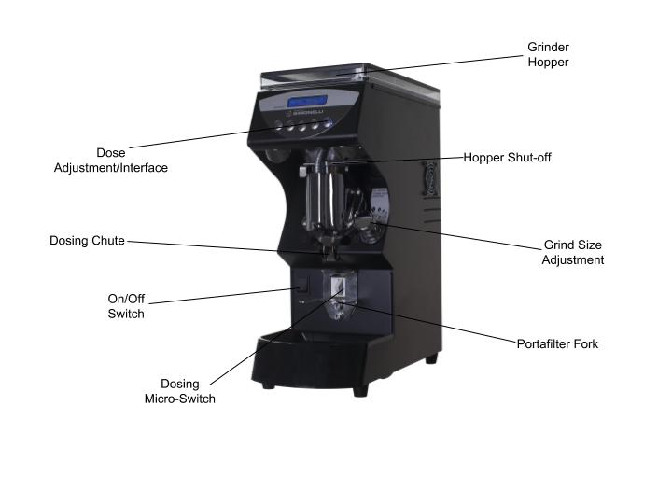
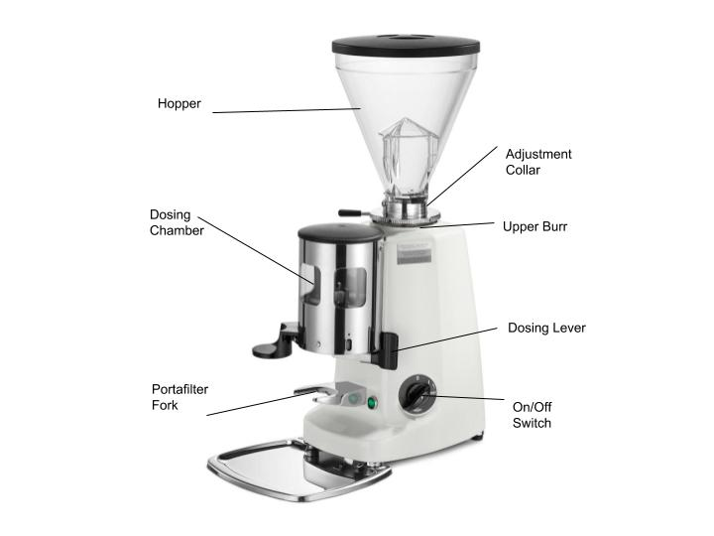
DOSER VS. ON DEMAND

Slide 20

DOSE OUTPUT
Grind adjustment moves burrs
closer or father (finer or coarser)
On-Demand (doserless) grinders may require time adjustment after grind size adjustment
Notes:
Talk and demonstrate

Slide 21
GRINDER HEAT
Grinding produces friction, which produces heat
Busy service causes heat buildup in burrs/change in coffee temperature
Causes static and decreased extraction
What grind size adjustment would be required?

Slide 22
QUESTIONS?
Workflow and placement
Double baring
Dose output
Heat

Slide 23
OBJECTIVES
Describe factors that impact consistency
Identify symptoms of dull grinder burrs
Identify causes of channeling
Describe the relation of brew ratio to flavor and body

Slide 24
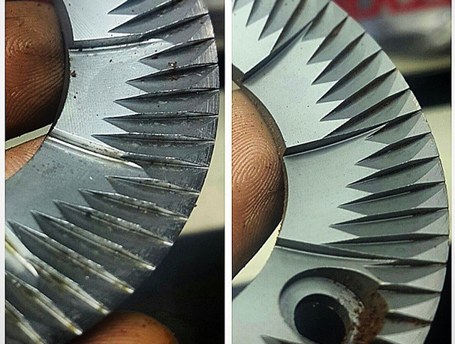
BURR SHARPNESS
Burr quality impacts many areas of coffee extraction
Causes

Slide 25
CONSISTENCY
Controlling variables to maintain quality involves keeping consistency in methodology and preparation of beverages

Slide 26

CHANNELING
Uneven flow of water
Even distribution is key
Uneven flow means uneven
extraction

Slide 27
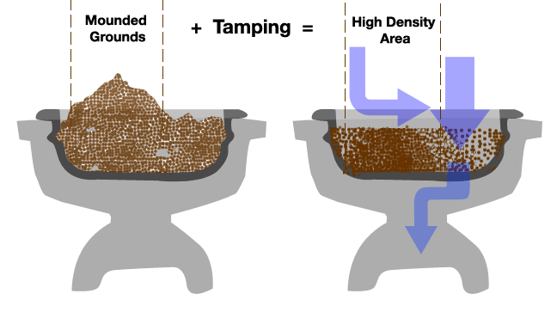
CHANNELING

Slide 28
QUESTIONS?
Maintaining consistency
Channeling
Achieving balance
Making adjustments

Slide 29
OBJECTIVES
Recognize flavor compounds extracting at different times
Split a shot into three parts, identify by appearance and taste
Describe how to correct imbalance
Identify by taste, balanced and sweet espresso as opposed to overly sour or bitter
Understand how to use a refractometer

Slide 30
BALANCE
Acidity
Sweetness
Bitterness

Slide 31
EXTRACTING COMPOUNDS
Acidity
Extraction of acids
Sweetness
Extraction of sugars, carbohydrates
Bitterness
Alkaloids, polyphenols, tannins
Notes:
Pull shot and split into 3 components

Slide 32
CORRECTING IMBALANCE
Yield (output weight)
Grind size
Dose weight
Notes:
Talk about each variable and what it changes

Slide 33
CORRECTING IMBALANCE
Taste and describe espresso at parameters given
Make variable adjustment
Test new parameters
Notes:
Talk about each variable and what it changes

Slide 34
BREW RATIO
Espresso Brew Formula (EBF)
EBF = (espresso dose weight ÷ espresso beverage weight) × 100
40% EBF
60% EBF

Slide 35
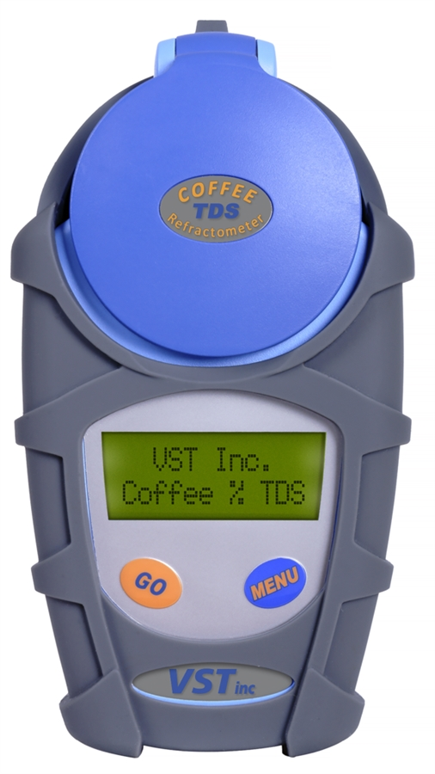
REFRACTOMETER
Tool for reading TDS
Software - VST CoffeeTools
Based on how much light can pass through the liquid

Slide 36
QUESTIONS?
Extraction of acids, carbohydrates, alkaloids
Brew ratio and its impact on flavor
Refractometers and TDS

Slide 37
OBJECTIVES
Use the SCA Flavor wheel to describe attributes in espresso
Understand milk composition, protein and fat content
Demonstrate correct milk foam texture
Understand milk alternatives and limitations

Slide 38
SCA FLAVOR WHEEL
Developed by a sensory panel of professionals from various companies
Provides framework for communication
Helps teams get calibrated
Notes:
They’ve all seen it before - providing more details on history and purpose
Also mention drawbacks - mainly Western focused (different countries/cultures have different fruits, flavor references, etc.)
A great tool but not perfect, continually edited (Revised version coming soon)

Slide 39
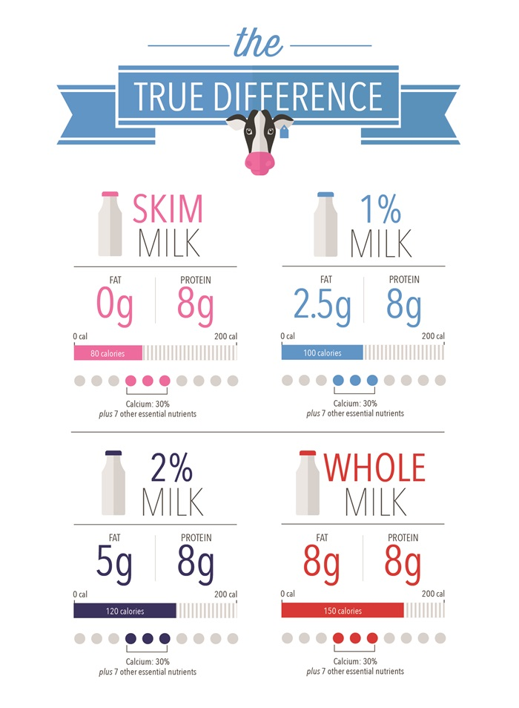
MILK COMPOSITION
Fat
Protein
Notes:
Talk about differences between Whole/Skim Milk

Slide 40

REVIEW: MILK TEXTURE
Smooth, glossy
Melted marshmallow! (Or wet paint, whatever your taste preference is)

Slide 41
MILK ALTERNATIVES
Soy
Almond
Oat
Coconut, cashew, macadamia, etc.

Slide 42
QUESTIONS?
SCA Flavor Wheel
Milk composition
Milk texture
Alternatives

Slide 43
OBJECTIVES
Identify causes of incorrect milk foam texture
Demonstrate correct temperature and foam level
Consistently freepour two latte art patterns
Demonstrate milk sharing techniques

Slide 44
INCORRECT MILK TEXTURE
Lumpy or watery
Coagulated on top
Bubbles fizzing
May suggest milk is unfit for consumption.

Slide 45
REVIEW: TEMPERATURE
Desired range 131-149℉ (59.4-65℃)
Maximum 158℉(70℃)

Slide 46
FREE POURING
Monk’s head / dot
Heart
Tulip
Rosetta
Notes:
Activity - practice designs

Slide 47
MILK SHARING
Prepare milk for two cappuccinos in one pitcher
Pour cappuccinos while maintaining proper foam level in each drink

Slide 48
QUESTIONS?
Texture and temperature
Foam level
Free pouring designs
Milk sharing

Slide 49
OBJECTIVES
Prepare multiple beverages at different espresso to milk ratios
Demonstrate extracting espresso and steaming milk simultaneously
Prepare 4 beverages within 5 minutes

Slide 50
DRINK MENU
Macchiato
Cortado
Cappuccino
Latte

Slide 51
PRACTICE!
Pulling shots and steaming milk simultaneously

Slide 52
PRACTICE!
Prepare 4 drinks in 5 minutes

Slide 53
QUESTIONS?
Drink definitions
Pulling shots and steaming at the same time
Efficiency and order of preparing drinks

Slide 54
OBJECTIVES
Implement procedures for hygiene and safety
Identify risks of cross contamination
Minimize risks of direct contamination
Identify sources for workplace injury

Slide 55
HYGIENE & SAFETY
Towels
Hand washing
Milk pitchers

Slide 56
CROSS CONTAMINATION
Using your counter towel to wipe your steam wand
Using your drip tray towel to wipe the portafilter

Slide 57
DIRECT CONTAMINATION
Milk left out, incorrect storage temperatures
Storage containers left open
Pest control
Sneezing or coughing

Slide 58
WORKPLACE INJURY
Burns
Broken glass
Dropping tamp
Strained wrist from incorrect technique

Slide 59
WORKPLACE INJURY
Slipping from spills
Cleaning grinder burrs
Electrical cords
Chemicals stored near food

Slide 60
QUESTIONS?
Hygiene and safety
Cross contamination
Direct contamination
Possible injuries

Slide 61
OBJECTIVES
List the steps of customer recovery
Maintain high standards of personal presentation
Demonstrate good communication techniques
Demonstrate efficiency techniques for good customer service

Slide 62
CUSTOMER RECOVERY
Listen
Be sincere
Don’t try to deny, explain, make excuses
Ask what will make things right

Slide 63
PERSONAL PRESENTATION
Clean clothing, hair, and fingernails
Neat apron
Open body language and posture
Easy going demeanor
Notes:
Ask for examples of poor body language

Slide 64
COMMUNICATION
Ask questions
Give suggestions
Maintain communication during preparation
Confirm handoff

Slide 65
EFFICIENCY
Remember regulars
Manage lines, take orders quickly
Workflow to save time and energy
Maintain a clean and stocked station

Slide 66
QUESTIONS?
Customer recovery
Personal presentation
Communication
Efficiency strategies

Slide 67
OBJECTIVES
Explain how single and multiple boiler espresso machines function
Understand importance of preventative maintenance
Understand cafe management practices and costs involved

Slide 68
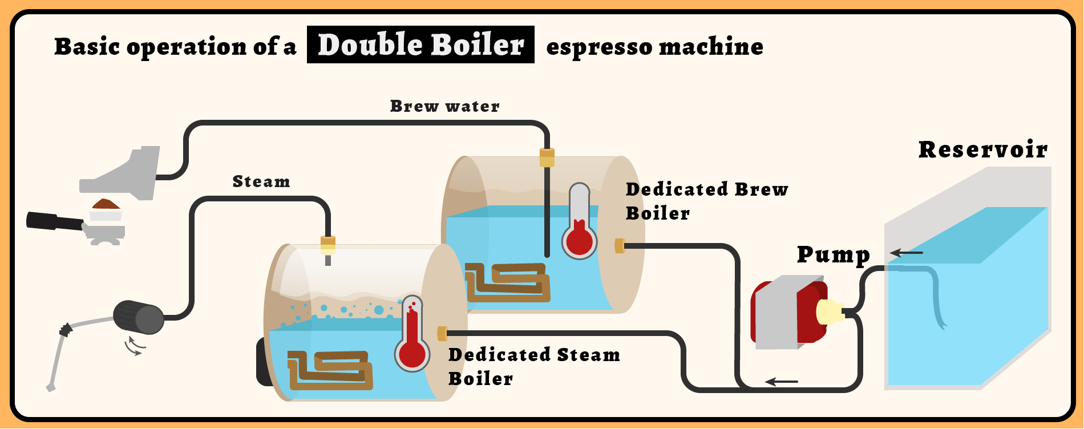
SINGLE vs. DOUBLE BOILER
Notes:
Upsides: More temp stable, higher capacity, faster
Downsides: more complicated, requires more energy

Slide 69
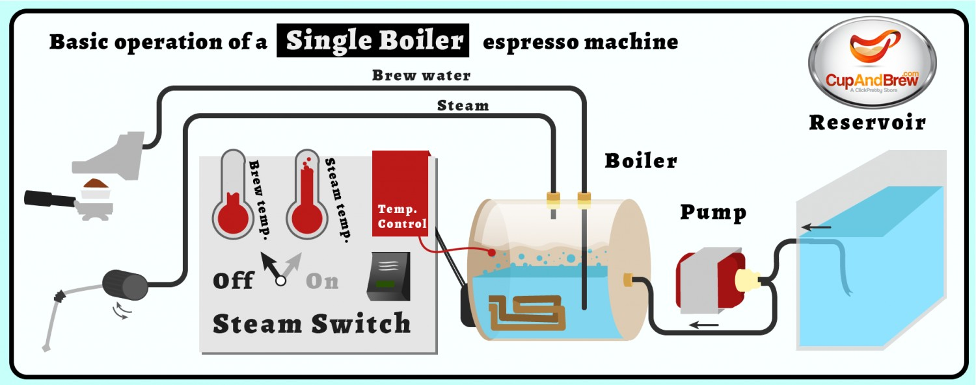
SINGLE vs. DOUBLE BOILER
Notes:
Upsides: Simple, smaller,
Downsides: Slow, low volume, less flexible

Slide 70
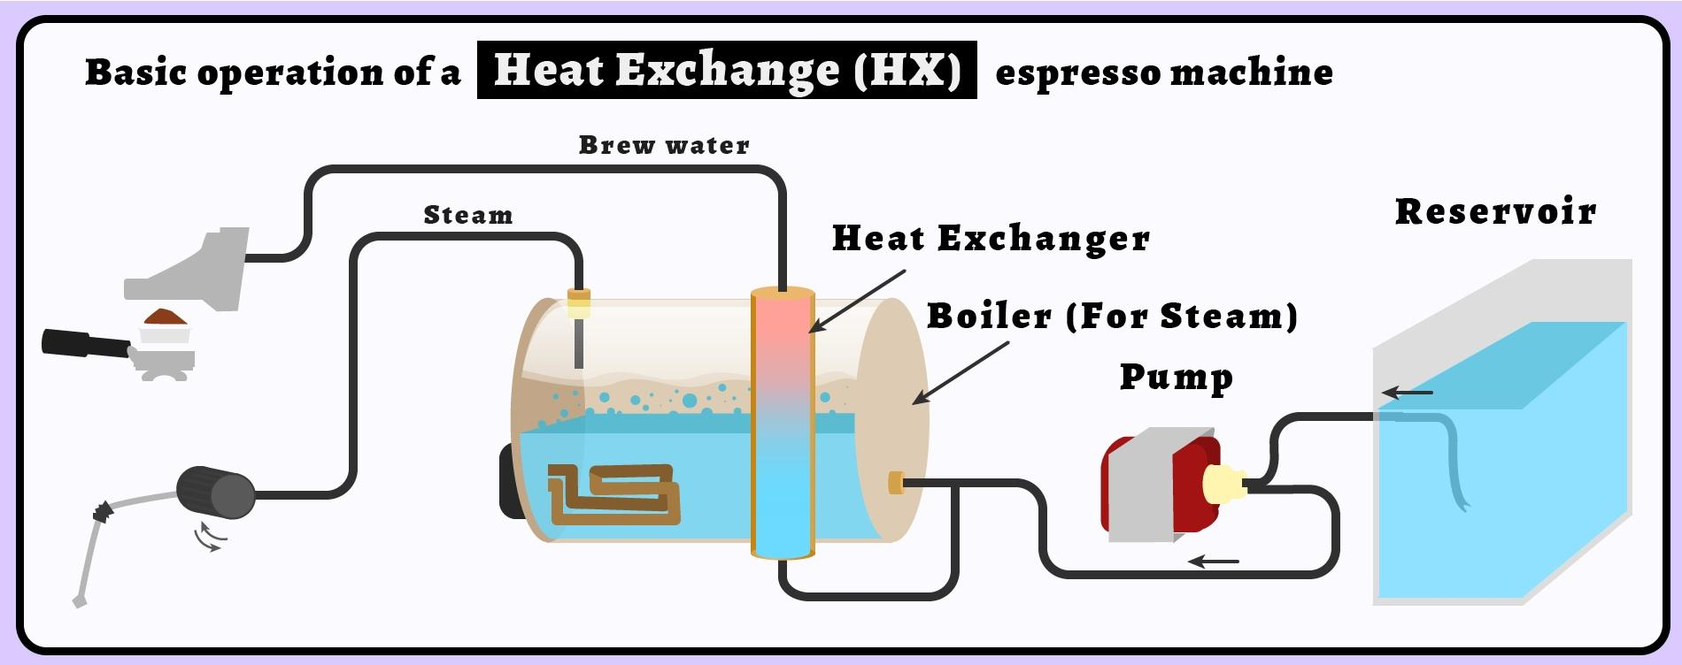
SINGLE vs. DOUBLE BOILER
Notes:
Upsides: small, simple
Downsides: Temperature less stable, recovery may not keep up with volume

Slide 71
PREVENTATIVE MAINTENANCE
Backflushing daily
Using correct detergents + solutions
Replacing gaskets
Checking water filtration
Notes:
Explain backflushing
Importance of correct detergents
Replacing gaskets on a schedule
Checking filtration to make sure water is correct

Slide 72
CAFE MANAGEMENT
Calculating costs
Ingredient storage
Strategies to minimize waste
Human Resources

Slide 73
QUESTIONS?
Single and double boilers
Preventative maintenance
Cafe management

Slide 74
SUMMARY
Coffee varieties, regions, processing methods, and general flavor profiles
Deeper understanding of espresso extraction and milk steaming
Workflow and efficiency
Best practices for safety, customer service, equipment maintenance and cafe management

Slide 75
REVIEW
Name the two main species of coffee

Slide 76
REVIEW
Bourbon and Typica are types of...

Slide 77
REVIEW
Describe the body of a natural process as opposed to a washed coffee…
(from the same farm)

Slide 78
REVIEW
How does the washed process typically affect acidity?

Slide 79
REVIEW
Give some examples of differences between fresh roasted and rested coffee extraction...

Slide 80
REVIEW
What does coffee release after roasting?

Slide 81
REVIEW
Describe the most efficient way to arrange your station (equipment placement)

Slide 82
REVIEW
Explain double baring...

Slide 83
REVIEW
How would you adjust your grind setting during peak times?

Slide 84
REVIEW
How does adjusting your grind setting affect your dose?

Slide 85
REVIEW
How would you adjust your grind setting during peak times?

Slide 86
REVIEW
Describe channeling…
How do you avoid it?

Slide 87
REVIEW
How do you identify under vs. over extracted espresso by taste?

Slide 88
REVIEW
Explain the difference between steaming whole vs. skim milk...

Slide 89
REVIEW
What are some indicators that milk is not ok to consume?

Slide 90
REVIEW
How does buildup of coffee on the grouphead affect the flavor of espresso?

Slide 91
REVIEW
How do you know when to replace your grinder burrs?

Slide 92
REVIEW
How do worn burrs affect drink quality?

Slide 93
REVIEW
How do you calculate profit margin?

